Slide 1
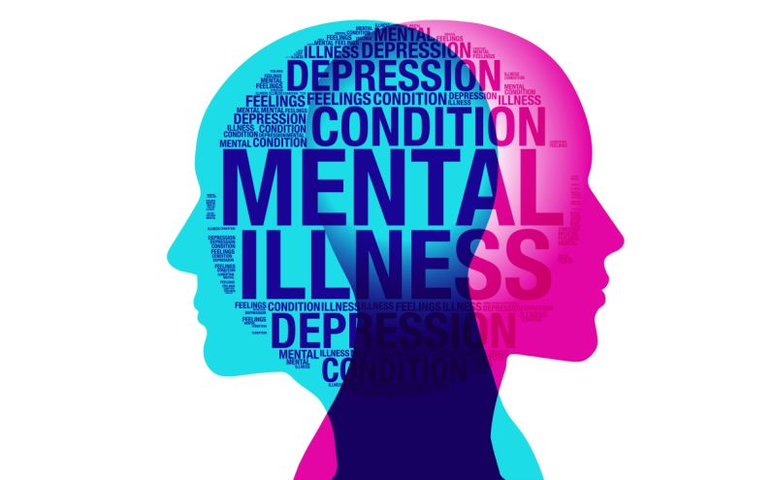
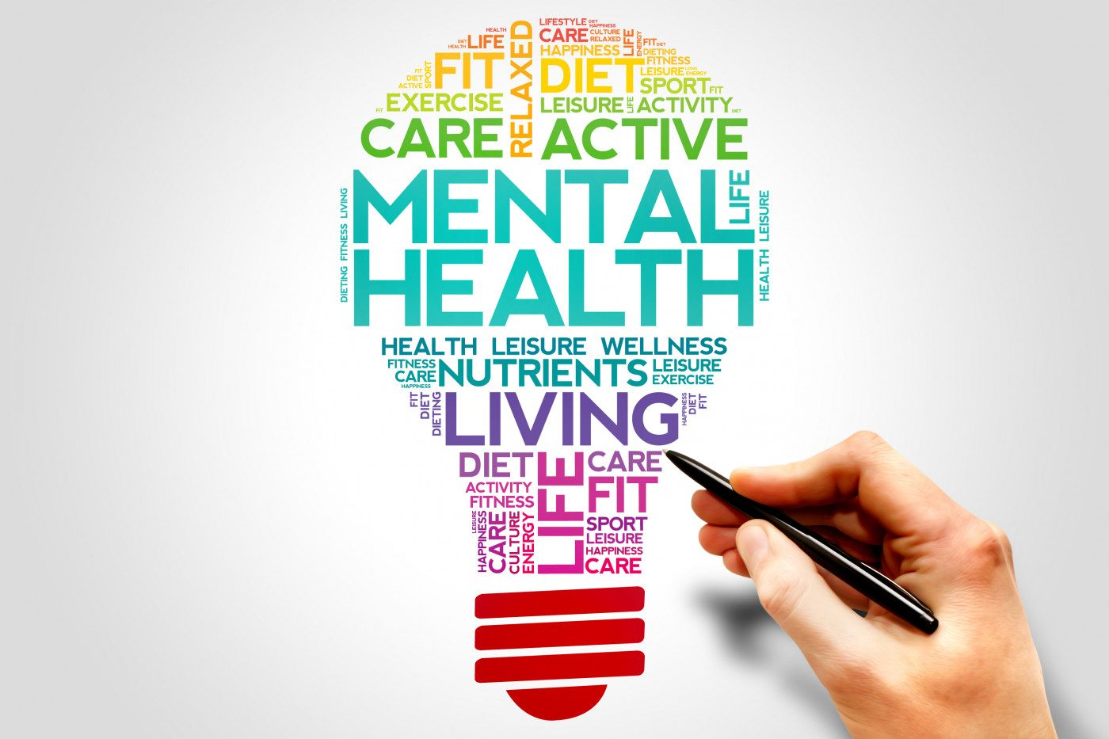
Mental Health Analysis ChatBot INSPRED
By: Aryan D.M –16UG08006
Melvin Derrick – 16UG08021
Sowjanya – 16UG08057
Srikanth S – 16UG08059

Slide 2
Contents:
Introduction
Objectives
Literature Survey
Software and Hardware Requirements
System Development Process
System Implementation
Implementation of codes
Results and Analysis
Screenshots
Conclusion
References

Slide 3
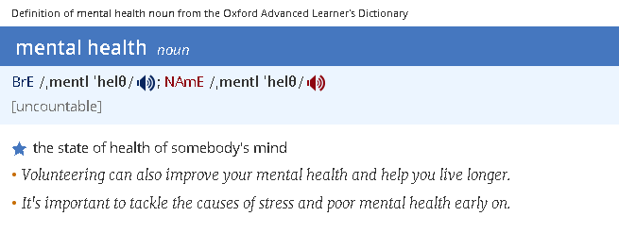
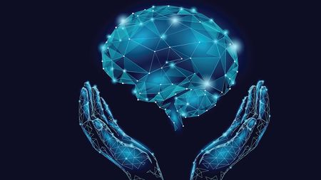
What is Mental Health

Slide 4
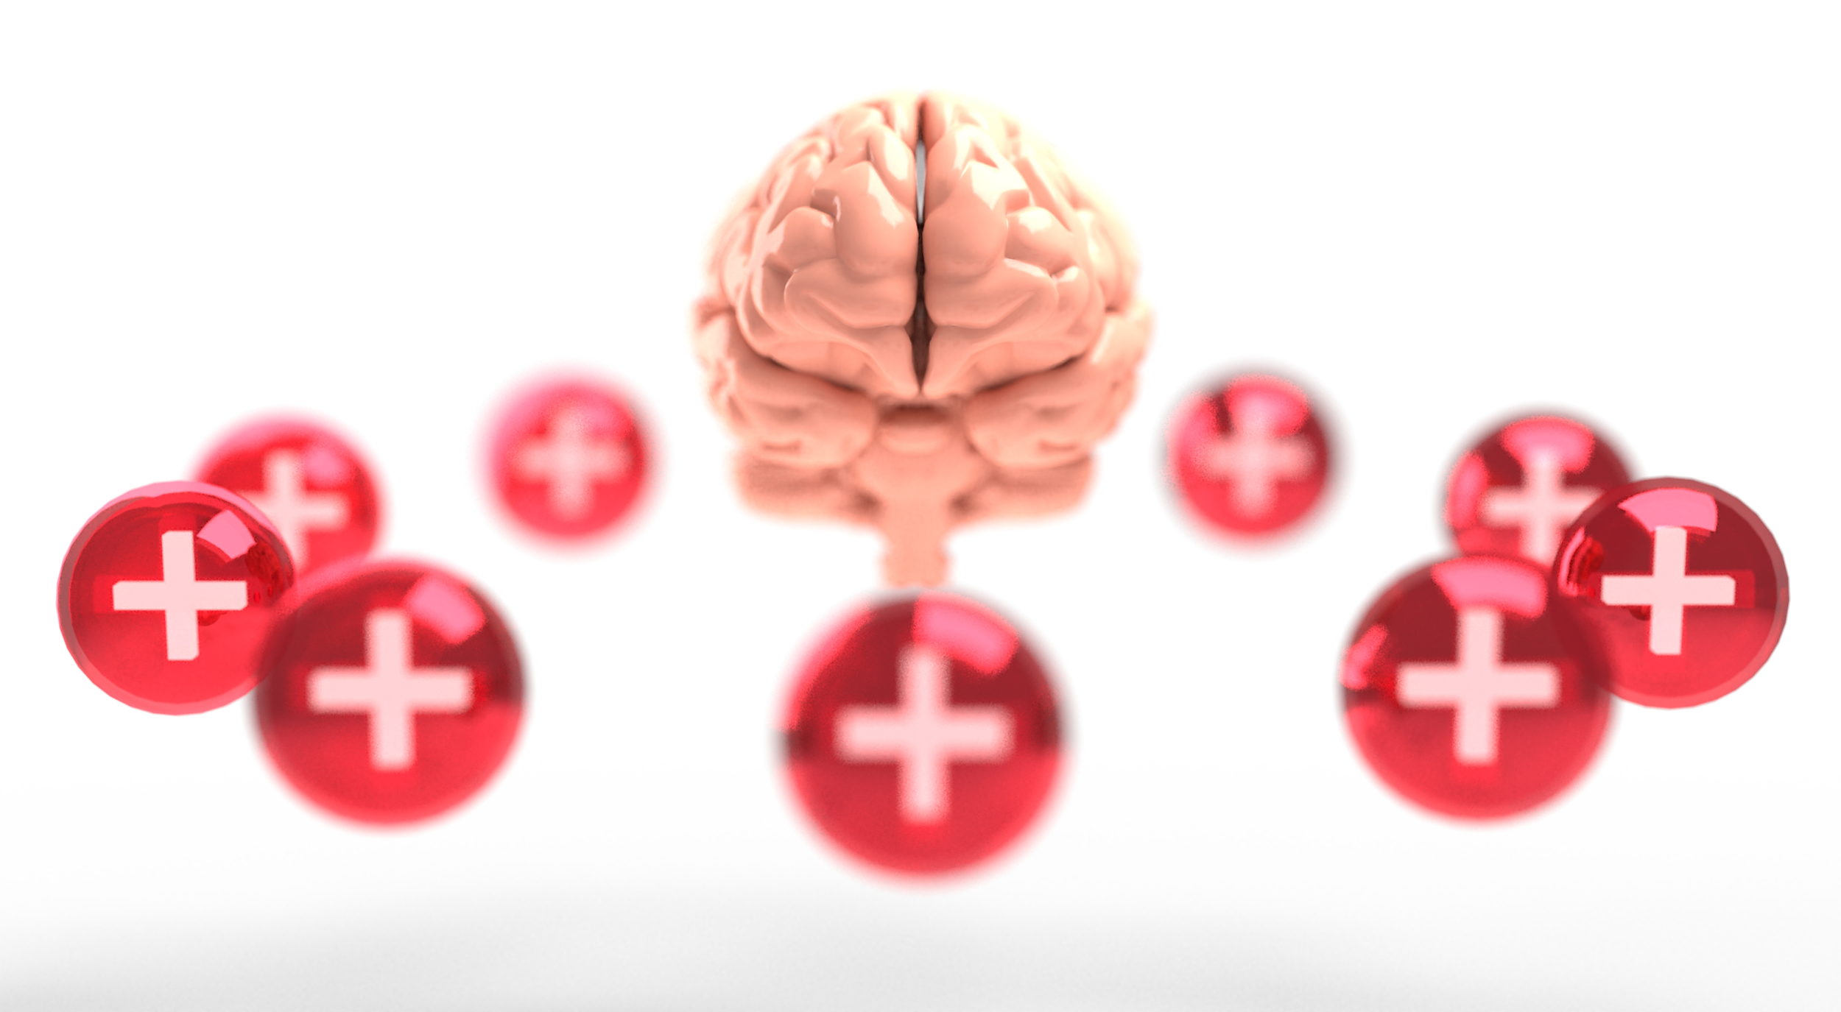

Mental Health according to WHO
According to the WHO (World Health Organization), mental health is:
"... a state of well-being in which the individual realizes his or her own abilities, can cope with the normal stresses of life, can work productively and fruitfully, and is able to make a contribution to his or her community."
The WHO stresses that mental health "is not just the absence of mental disorder."

Slide 5
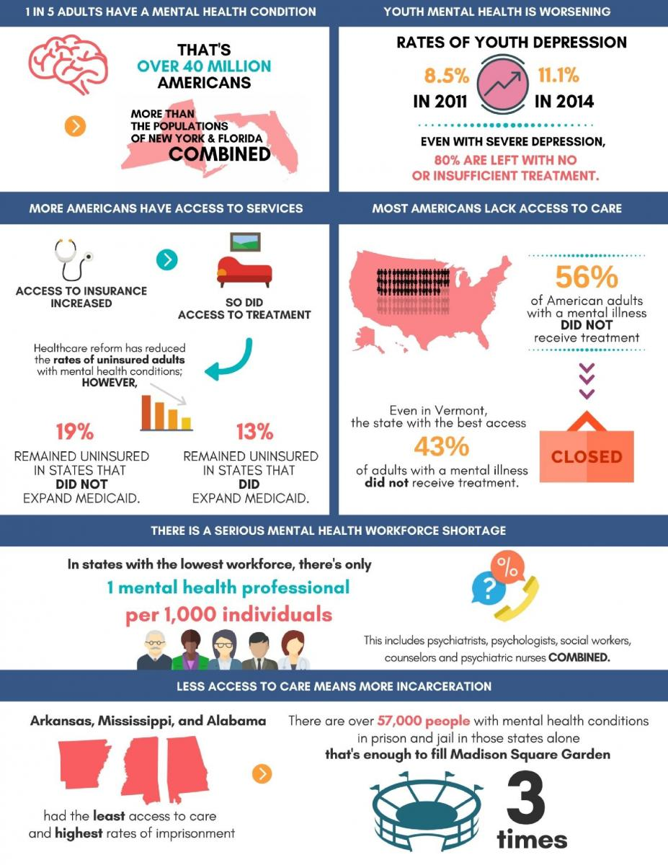
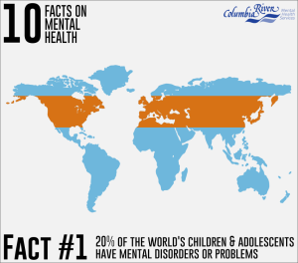
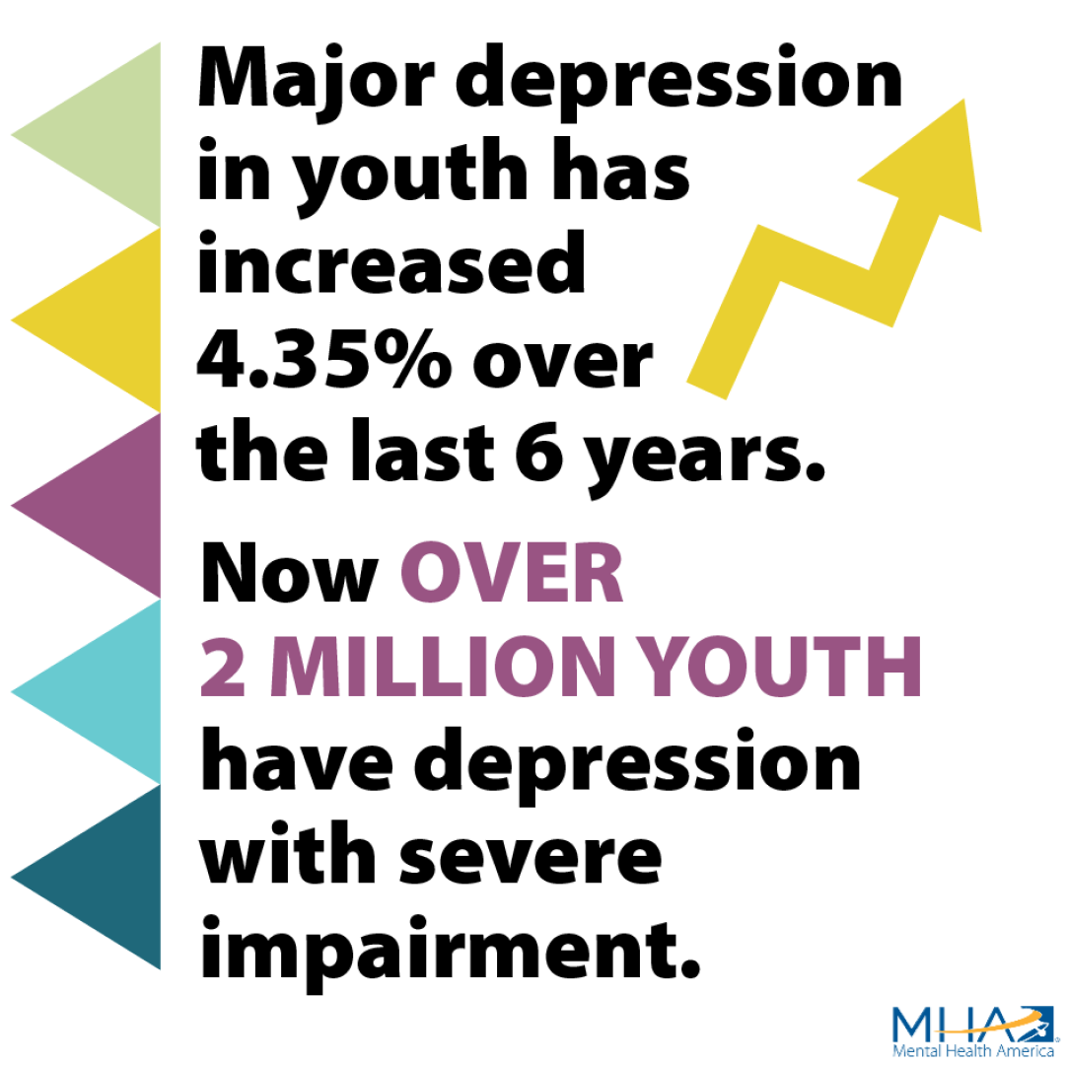
Why Mental Health??

Slide 6
Introduction
This project Mental Health Analysis ChatBot INSPIRED. The primary goal of this project is to extract patterns from a Mental health counselling dataset, and then build a model based on these extracted patterns, in order to predict the mental health issues. The project Mental Health Analysis ChatBot INSPIRED which is built using Reactjs, Python and other tools. The main objective is, Talk to Inspired chatbot and experience the human touch of a robot, Share your emotions with smash the councelling expert.

Slide 7
Objectives:
Mental health issues such as stress, anxiety, and depression are among the health information most searched for by teenagers online, and online content often motivates young people to change their health behaviors.
Chatbots may offer great potential for providing people with useful help for mental health difficulties. There are, however, several ethical issues associated with this potential. While testing the chatbots, we were particularly concerned about matters related to who has access to users’ personal information and conversations; whether the digital support provided is evidence-based; and how automated bots protect users’ safety in emergency situations.
For their potential not to be compromised, we believe that automated bots should meet a set of minimum ethical standards concerning privacy and confidentiality, efficacy, and safety.

Slide 8
Literature Survey
Ln[1]: The paper by Kira Kretzschmar, Holly Tyroll, Gabriela Pavarini, Arianna Manzini and Ilina Singh [1] discussed about Can your phone be your therapist? Young people ethical perspectives on the use of fully automated conversational agent (chatbots) in mental health support. This article arguing that bots like Woebot, Wysa, and Joy might have great potential to provide help to people struggling with mental health problems.
Ln[2]: Sandhya P, Mahek Kantesaria [2] their paper stated about the Prediction of Mental Disorder for employees in IT Industry. In this paper they discussed about the implementation of different machine learning algorithms like logistic regression, Knn, Decision tree, Random forest, Bagging, Boosting, Neural network. Mental health is nowadays a topic which is most frequently discussed when it comes to research but least frequently discussed when it comes to the personal life.

Slide 9
Ln[3]: The paper by Prof. Danilo Bzdok, M.D., Ph.D. & Prof. Andreas Meyer-Lindenberg, M.D [3] discussed about the concept of Machine learning for precision psychiatry. The nature of mental illness remains a conundrum. Yet, psychiatrists and investigators now have an unprecedented opportunity to benefit from complex patterns in brain, behavior, and genes using methods from machine learning (e.g., support vector machines, modern neural-network algorithms, cross-validation procedures).
Ln[4]: Proff. Carola-Bibiane Schonlieb, Proff. Terry Lyons and Proff. Peter Tino [4] proposed about the Predicting mental health early and precisely has major implications for clinical management and practice, and ultimately life expectancy. This project will use machine learning techniques to produce robust modelling tools that aim to improve the precision of clinical practice in mental health. Machine learning will be used to predict and classify disease risk at an individual level (for dementia, anxiety, depression, and others) and to determine the interactive factors that influence mental health across people’s lifespans (e.g. genetics, cognition, demographics).

Slide 10
Ln[5]: The paper by M. Srividya & S. Mohanavalli1 & N. Bhalaji [5] discussed about the Behavioral Modeling for Mental Health using Machine Learning Algorithms. The aim of this research work is to identify the individuals who are mentally distressed in the target population. These individuals need special attention in order to mentally balanced population. The basic form of getting to know about individuals in a population is to get responses for common benchmarked questions and rate them depending on their responses. This research is a pilot work for further in depth study about different kinds of mental illness.
Ln[6]: Ms. Sumathi M.R., Research Scholar, and Dr. B. Poorna [6] they proposed about the Prediction of Mental Health Problems Among Children Using Machine Learning Techniques. Machine learning Techniques are currently well suited for analyzing medical data and diagnosing the problem. This research has identified eight machine learning techniques and has compared their performances on different measures of accuracy in diagnosing five basic mental health problems.

Slide 11
Software and Hardware Requirements
Hardware Platform:
• Intel/AMD Processor or any other compatible Processor, 1GHz or greater
• Minimum 500 B of RAM capacity or more
• Recommended hard disk space of 1 GB or more
Software Platform:
• Operating system : Windows/Linux/Mac
• Technology Used : Rectjs
• IDE : Jupitar Lab Python
• Framework : Java Script

Slide 12
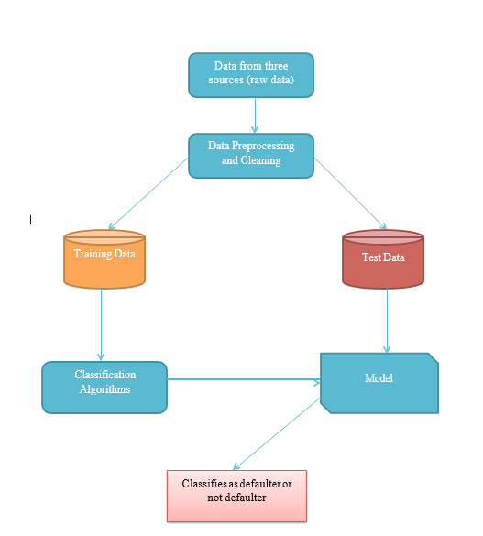
System Development Process
EXISTING SYSTEM:
Current existing system of the mental health analysis is only up to the defaulter classifiers. At present it is just predicting the mental health issues by taking the common issues in the society. As per the input given in data, system machine predict the problem and gives a default prediction.
Disadvantage:
In this current Existing system, we will not get answers in a natural language instead will get it in a machine proposed language.
At present there is no machine learning based website for the mental health analysis.

Slide 13
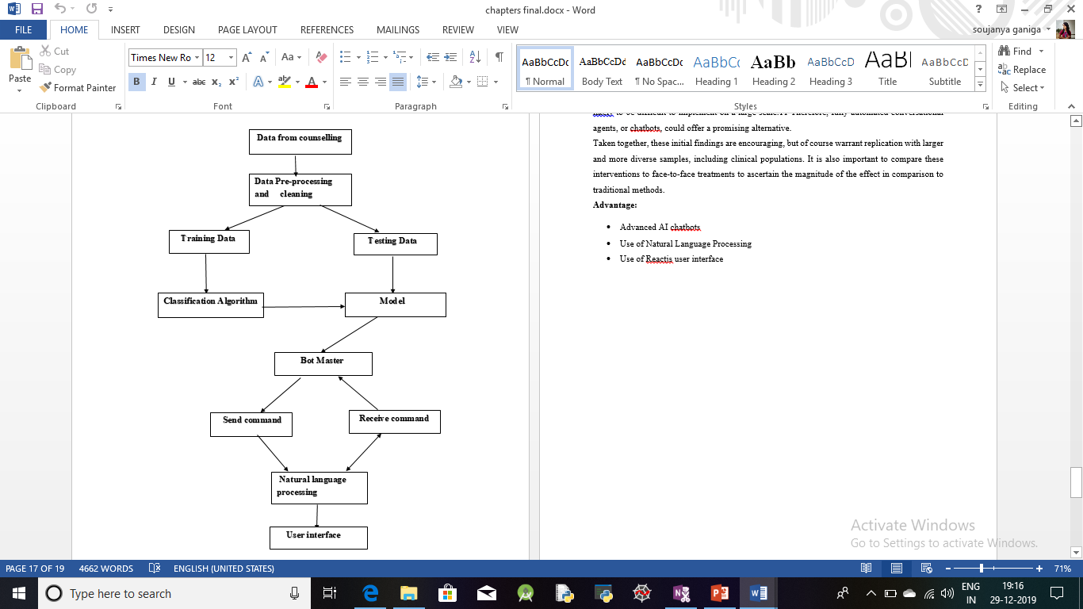
PROPOSED SYSTEM:
In the proposed system, we are implementing a AI based Chatbot and natural language processing system to process the output for the mental health patients and we are also making a user interface to communicate easily with the machine.
Advantage:
Advanced AI chatbots
Use of Natural Language Processing
Use of Reactjs user interface

Slide 14
System Implementation Framework used for Implementation:
Reactjs
React (also known as React.js or ReactJS) is a JavaScript library for building user interfaces. It is maintained by Facebook and a community of individual developers and companies. React can be used as a base in the development of single-page or mobile applications, as it is optimal for fetching rapidly changing data that needs to be recorded. React is a library for building composable user interfaces. It encourages the creation of reusable UI components, which present data that changes over time.
Jupitar Note Book:
Jupyter Notebook (formerly IPython Notebooks) is a web-based interactive computational environment for creating Jupyter notebook documents. The "notebook" term can colloquially make reference to many different entities, mainly the Jupyter web application, Jupyter Python web server, or Jupyter document format depending on context.

Slide 15
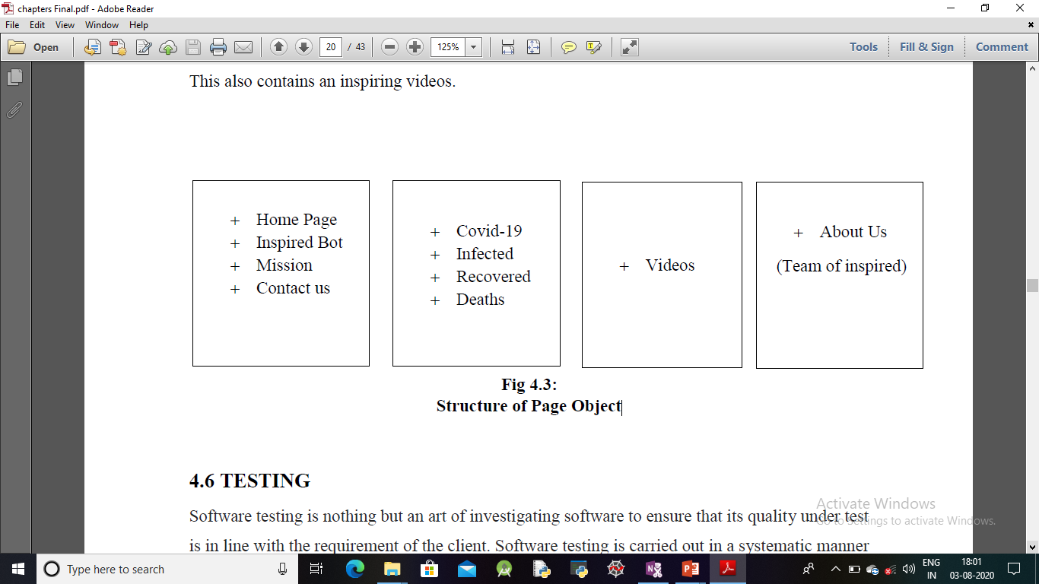
Implementation Module:

Slide 16
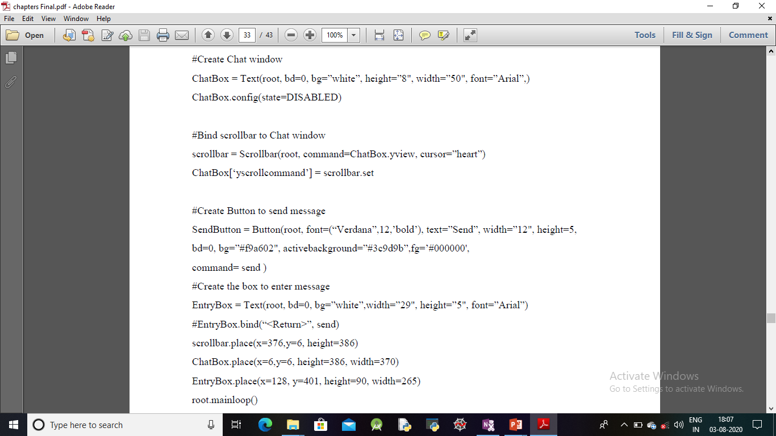
Codes Implementation:

Slide 17
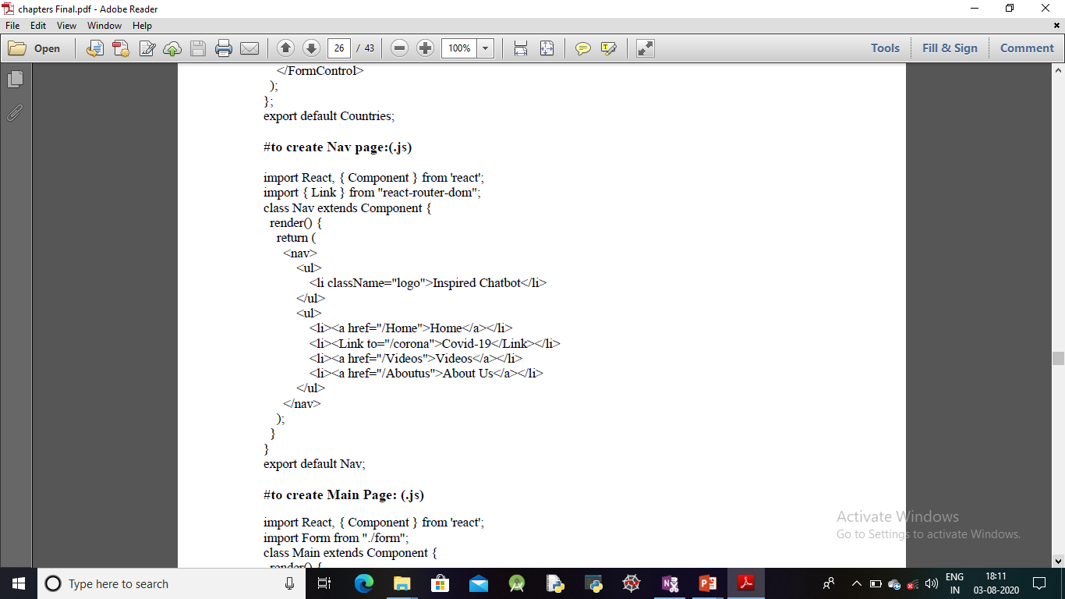
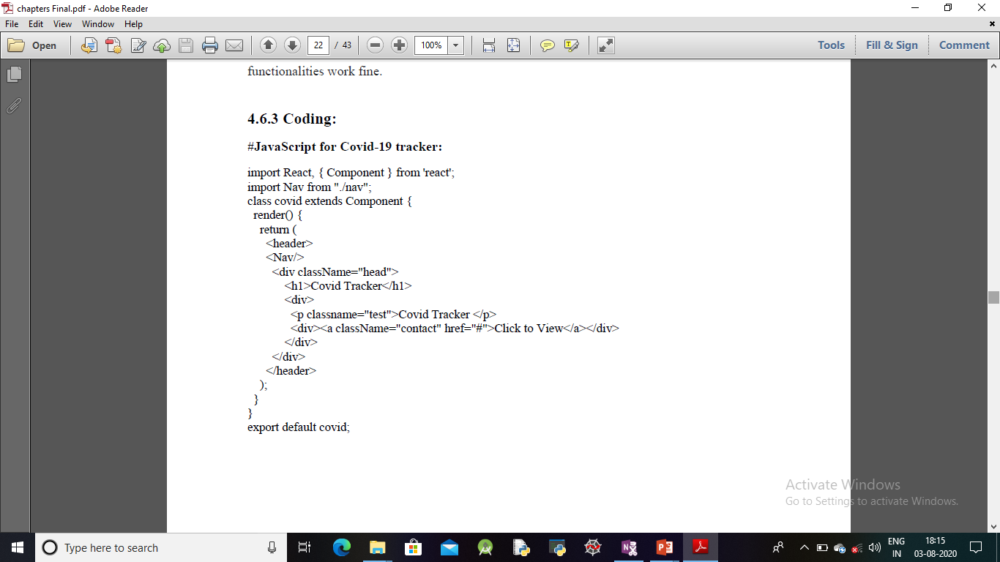

Slide 18
Results and Analysis
As we mentioned in the objective of the project we implemented a required contents for the project. The data suggested in the Chatbot the digital mental health interventions are likely to affect young people in a very important dimension of their lives.
And, the users receive reports that might help them gain insight into their own patterns, as well as targeted therapy exercises, including reframing one’s thoughts, mindful breathing, and motivational interviewing, in the form of text, games, or video clips.
As we know about the current pandemic that is corona, Our team has been successful in making the Covid-19 live dashboard. Because it is also helps keeps people updated and during this pandemic people might also suffer mental stress.
And we successful in implementing some inspiring videos which may help to overcome mental stress, anxiety etc.,.
The main mission of the project is, To make the world a better place where people are felt important and valued for what they are. We don’t Judge we just empathise and share love which is in abundance.
We as Team Smash want to impact everyone who visits our website. We want to do the least desired job of all to listen to your problems have empathy with the situations you go through.
For their potential not to be compromised, we believe that automated bots should meet a set of minimum ethical standards concerning privacy and confidentiality, efficacy, and safety.

Slide 19
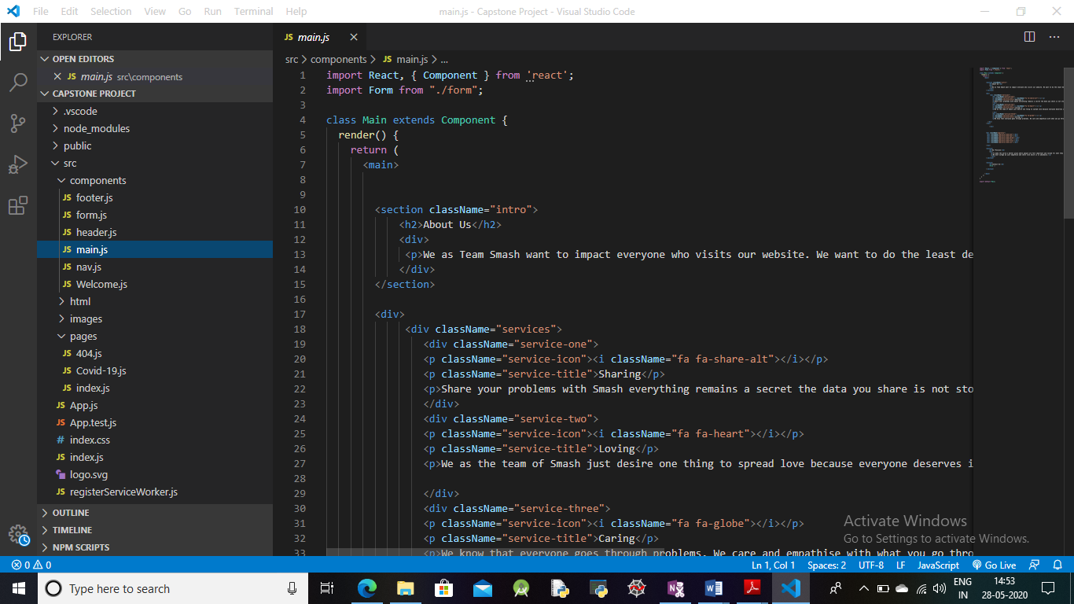
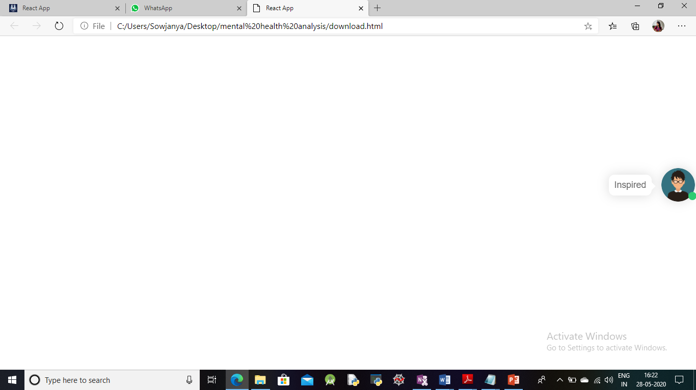
Screenshots Creation script Opening browser window

Slide 20
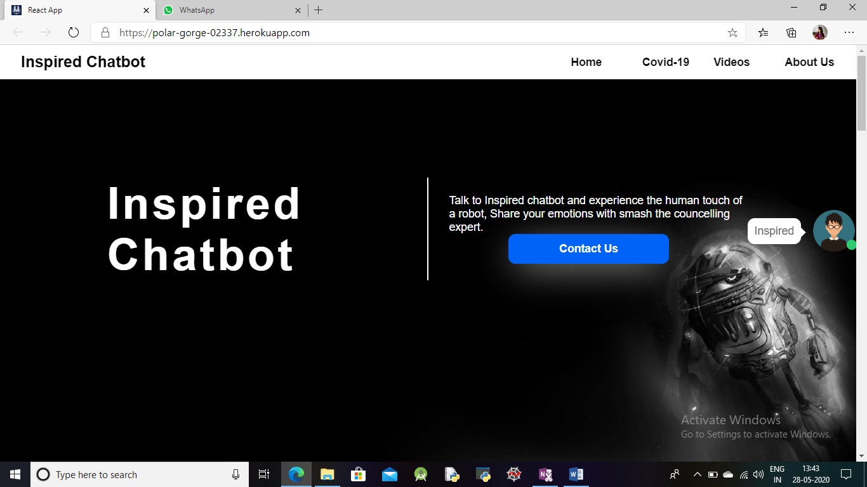
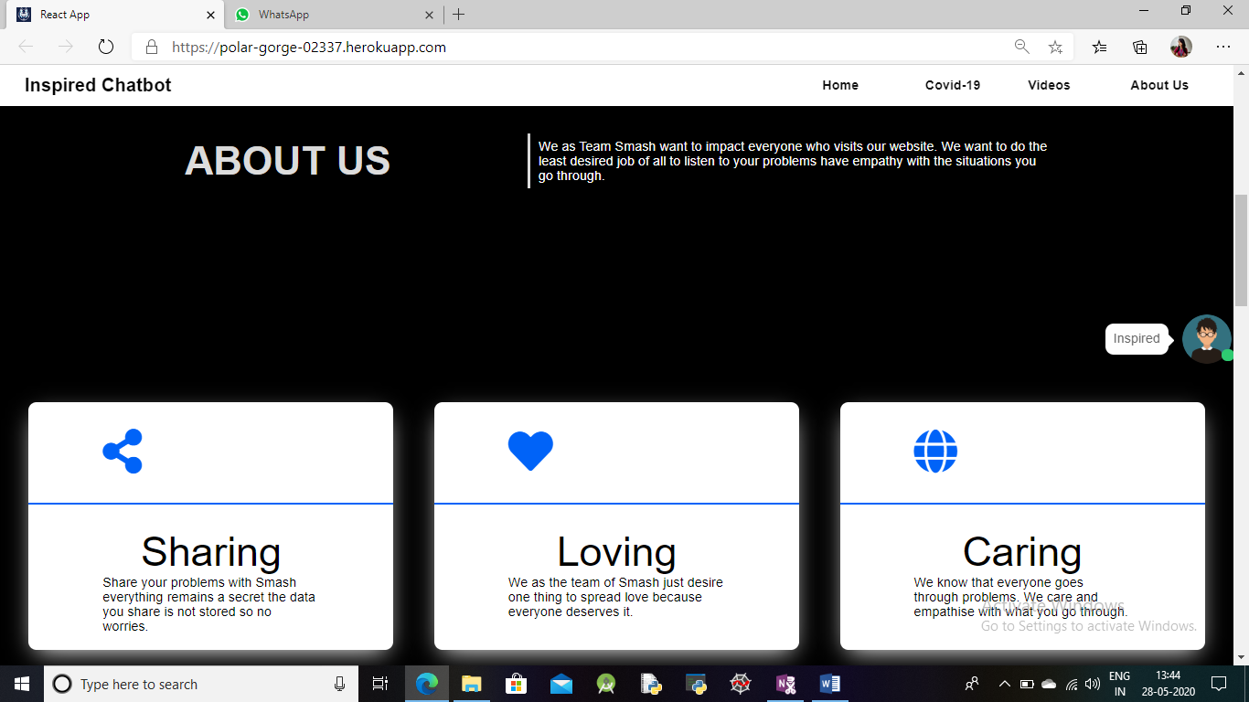
Home page 1 Home page 2

Slide 21
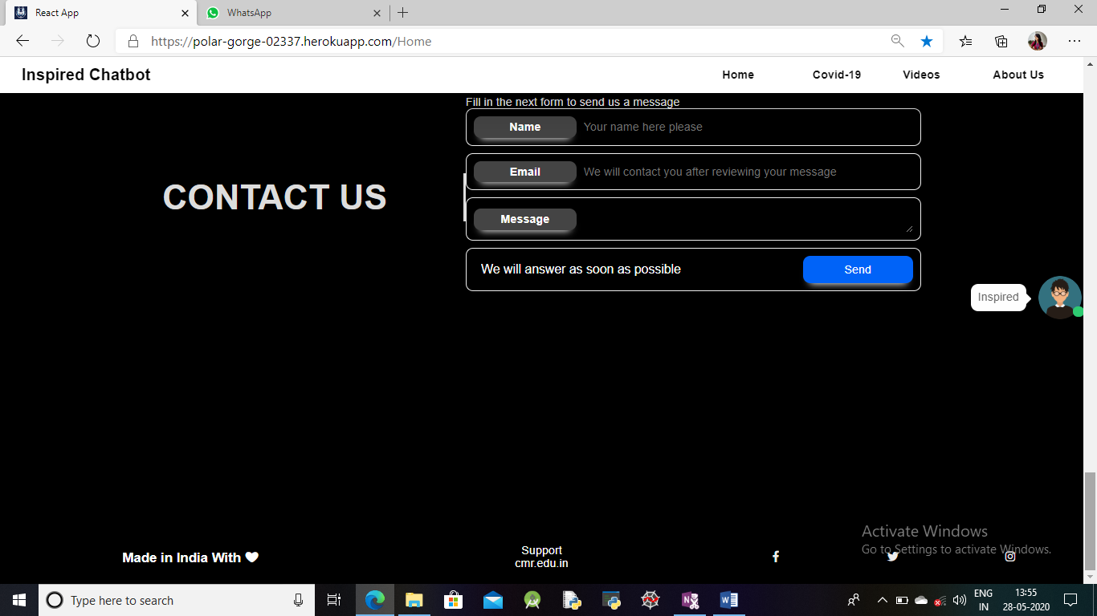
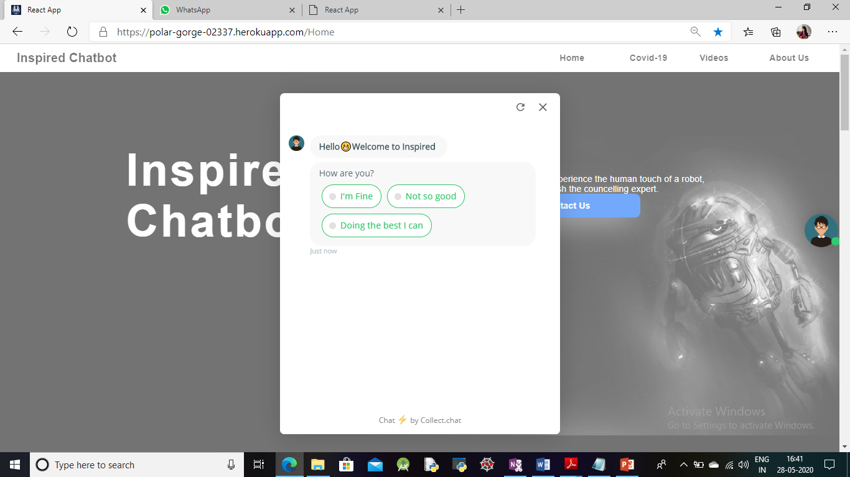
Contact info ChatBot

Slide 22
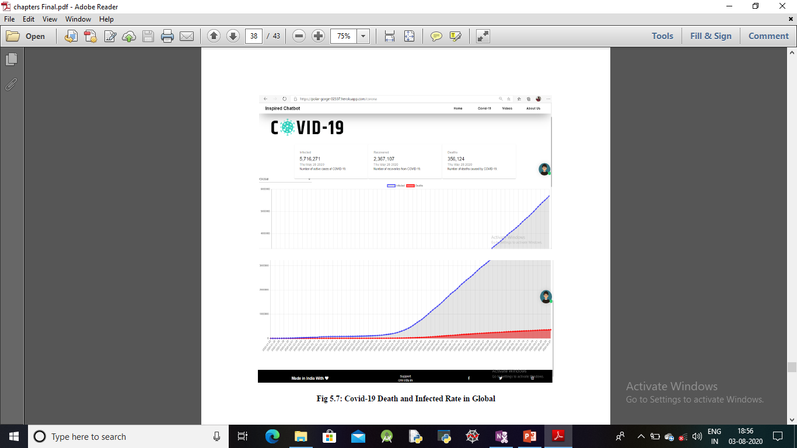
Covid-19 Death and Infected Rate in Global

Slide 23
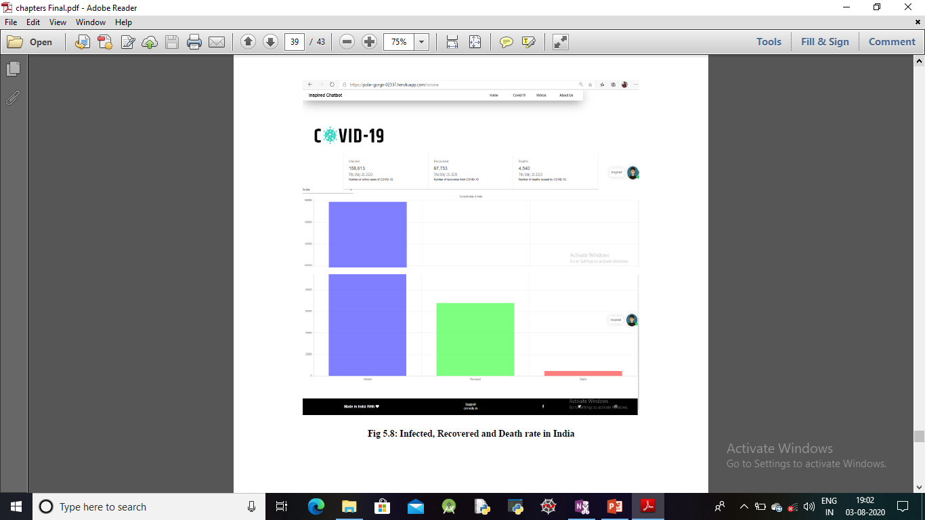
Infected, Recovered and Death rate in India

Slide 24
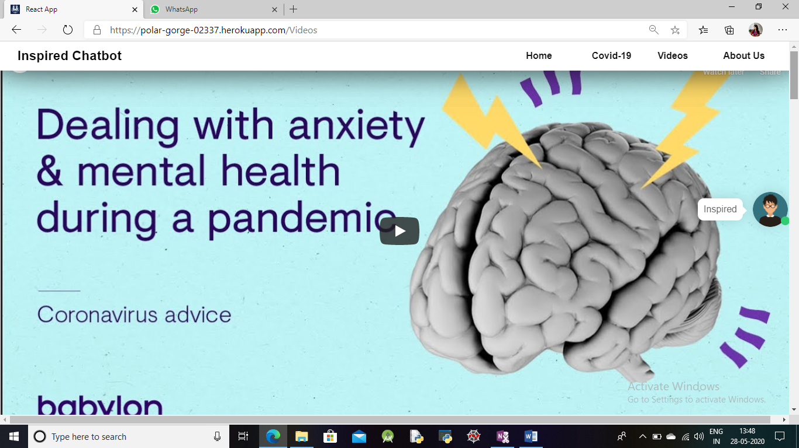
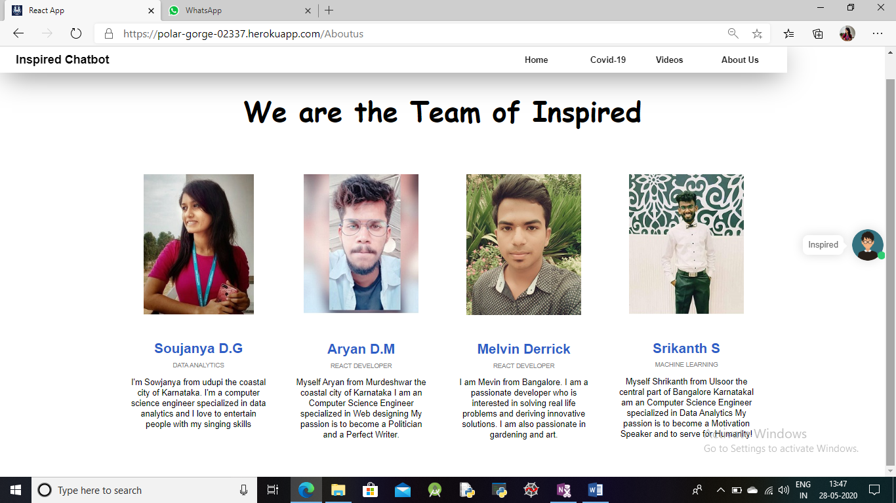
Videos Page About us

Slide 25
Conclusion:
In a development, we might not get enough time to specialize our new features of ChatBot in a time, so we duplicated a lot of code in many places. Refactoring code is an inherent part of software development to avoid building up a huge tech debt. Obviously, continuous improvement is essential if we are going to get a good return on investment from the website.
We have proposed a new framework React Java Script for designing Web Page.
The Web page is user friendly and easy to handle.
As we mentioned in the objective of the project we implemented a required contents for the project. The data suggested in the Chatbot the digital mental health interventions are likely to affect young people in a very important dimension of their lives.
As we know about the current pandemic that is corona, our team has been successful in making the Covid-19 live dashboard. Because it is also helps keeps people updated and during this pandemic people might also suffer mental stress.
Successful in implementing some inspiring videos which may help to overcome mental stress, anxiety etc.,

Slide 26
References
[1]. https://www.ncbi.nlm.nih.gov/pmc/articles/PMC4773121 [Kessler D, Lewis G, Kaur S, et al. Therapist-delivered Internet psychotherapy for depression in primary care: a randomised controlled trial. Lancet. 2009;374:628–634. Doi:10.1016/S0140-6736(09)61257-5.]
[2]. https://www.ncbi.nlm.nih.gov/pubmed/24844847 [Arnberg FK, Linton SJ, Hultcrantz M, Heintz E, Jonsson U. Internet-delivered psychological treatments for mood and anxiety disorders : a systematic review of their efficacy, safety, and cost-effectiveness. PLoS ONE. 2014;9:e98118. doi:10.1371/journal.pone.0098118.]
[3]. https://www.ncbi.nlm.nih.gov/pmc/articles/PMC4820657 [Baumel A, Schueller SM. Adjusting an available online peer support platform in a program to supplement the treatment of perinatal depression and anxiety. JMIR Ment Health. 2016;3:e11. doi:10.2196/mental.5335].
[4]. https://www.ncbi.nlm.nih.gov/pmc/articles/PMC6402067 [Leykin Y, Muñoz RF, Contreras O, Latham MD. Results from a trial of an unsupported internet intervention for depressive symptoms. Internet Interv. 2014;1:175–181. doi:10.1016/j.invent.2014.09.002.Results].
[5]. https://www.ncbi.nlm.nih.gov/pubmed/25093485 [Adelman CB, Panza KE, Bartley CA, Bontempo A, Bloch MH. A metaanalysis of computerized cognitive-behavioral therapy for the treatment of DSM-5 anxiety disorders. J Clin Psychiatry.2014;75:e695–e704. doi:10.4088/JCP.13r08894.]
[6]. https://www.tandfonline.com/doi/full/10.1080/16506070903318960 [Andersson G, Cuijpers P. Internet-based and other computerized psychological treatments for adult depression: a meta-analysis. Cogn Behav Ther. 2009;38:196–205. doi:10.1080/16506070903318960].
[7]. https://www.ncbi.nlm.nih.gov/pubmed/28546138 [Grist R, Porter J, Stallard P. Mental health mobile apps for preadolescents and adolescents: a systematic review. J Med Internet Res. 2017;19:e176. doi:10.2196/jmir.7332].
[8]. https://europepmc.org/articles/PMC2762797 [Christensen H, Griffiths KM, Farrer L. Adherence in Internet interventions for anxiety and depression. J Med Internet Res. 2009;11:e13. doi:10.2196/jmir.1194].
[9]. https://www.thelancet.com/journals/lanpsy/article/PIIS2215-0366(18)30230-X/fulltext [Sachan D. Self-help robots drive blues away. Lancet Psychiatry. 2018;5:547. doi:10.1016/S2215-0366(18)30230-X].

Slide 27
Thank You

